Slide 1
Snort As A Packet Logger
, ,_
o" )~
' ' ' '
Miles Brown, Zane Sampey, Marcus Simmons

Slide 2
What is Snort?
Snort is a free Open Source Intrusion Detection/Prevention System (IPS/IDS) that monitors network traffic and identifies potentially malicious activities on Internet Protocol (IP) networks. It was developed in 1998 by Martin Roesch. Now it is being developed by Cisco.

Slide 3
Modes of Operation
Snort can be configured to run in three different modes:
Sniffer mode, which simply reads the packets off of the network and displays them for you in a continuous stream on the console (screen).
Packet Logger mode, which logs the packets to disk.
Network Intrusion Detection System (NIDS) mode, which performs detection and analysis on network traffic. This is the most complex and configurable mode.

Slide 4
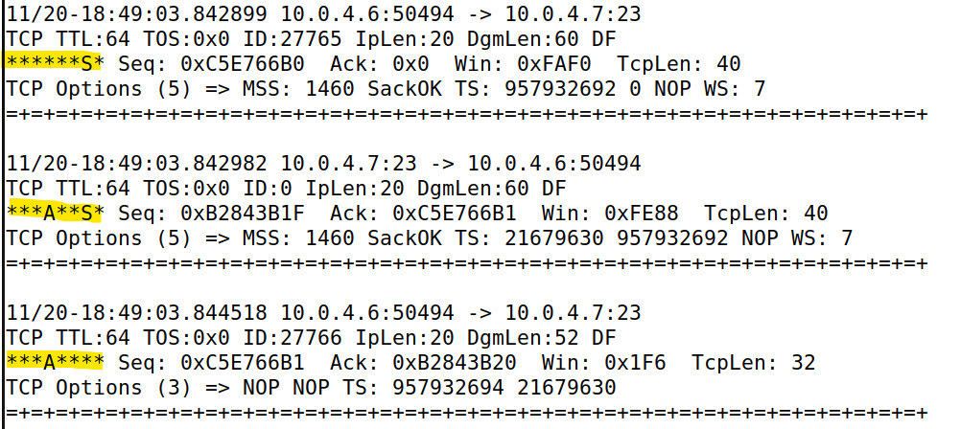
Sniffing the TCP 3-Way Handshake
Notes:
pcap

Slide 5
Relevant Directories
/etc/snort
Stores Snort files
Snort.conf
/Rules
/var/log/snort
Stores log files generated by Snort

Slide 6
Rule Writing
General Format:
action protocol sourceIP sourcePort -> destinationIP destinationPort (options)............................................
example:
log tcp 10.0.4.6 any -> 10.0.4.7 23 (msg: “Telnet Connection”;).......................................................
Notes:
Snort uses a simple but flexible rules language to describe network packet signatures and associate them with actions.

Slide 7
Actions
Alert…. - Alert on current packet
Block - Block current and subsequent packets
Drop - Drop current packet
Log….. - Log current packet
Pass - Mark current packet as passed
Notes:
Pass marks the current packet as passed

Slide 8
Protocols
ip
icmp
tcp
udp
Notes:
Pass marks the current packet as passed

Slide 9
IP addresses
They can be declared in one of four ways:
As a numeric IP address with an optional CIDR block (e.g., 192.168.0.5, 192.168.1.0/24)
As a variable defined in the Snort config that specifies a network address or a set of network addresses (e.g., $EXTERNAL_NET, $HOME_NET, etc.)
The keyword any, meaning any IP address
A list of IP addresses, IP address variables, and/or port ranges, enclosed in square brackets and separated by commas (e.g., [192.168.1.0/24,10.1.1.0/24])

Slide 10
Port Numbers
Ports are declared in a few different ways:
As any ports (meaning match traffic being sent from or to any port)
As a static port (e.g., 80, 445, 21)
As a variable defined in the Snort config that specifies a port or set of ports (e.g., $HTTP_PORTS)
As port ranges indicated with the range operator, : (e.g., 1:1024, 500:)
A list of static ports, port variables, and/or port ranges, enclosed in square brackets and separated by commas (e.g., [1:1024,4444,5555,$HTTP_PORTS])

Slide 11
Direction Operator
-> - It denotes that the IP addresses and port numbers on the left side represent the source and the IP addresses and port numbers on the right side represent the destination.
<> - It tells Snort to consider the two IP address and port pairs as either the source or destination.
Notes:
Pass marks the current packet as passed

Slide 12
Rule Options
msg - used to add a message describing the rule.
detection_filter - used to require multiple rule hits before generating an "event".
priority - assigns a severity level to a given rule to enable appropriate event prioritizing (1-2147483647).
flags - checks to see if the specified flag bits are set in the TCP header.
flow - used to check session properties of a given packet.
sid - uniquely identifies a given Snort rule.
rev - uniquely identifies the revision number of a given Snort rule.
Notes:
There are four main property categories that one can check with this option:
The direction of the packet, specifically whether it's from a client to a server or from a server to a client
Whether the packet is part of an established TCP connection or not
Whether the packet is a reassembled packet or not
Whether the packet is a rebuilt frag packet or not

Slide 13

Network Topology
Network: 10.0.4.0/24
Host A
10.0.4.6
Host B
10.0.4.7

Slide 14
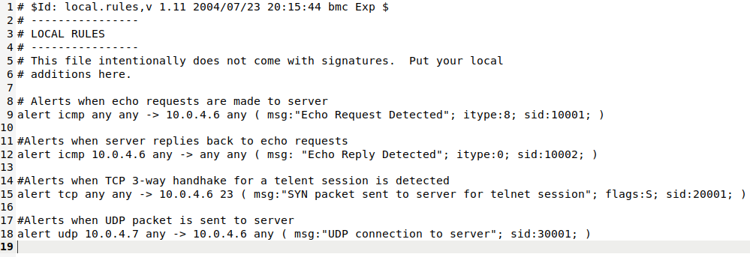
Local Rules
/etc/snort/rules/local.rules

Slide 15
Running Snort
sudo snort -q -l /var/log/snort -i ens34 -A console -c /etc/snort/snort.conf
q - quiet operation (No banner or initialization information)
l - Specifies the directory to send log files to
i - Specifies interface to sniff
A - Use alert mode and send alerts to the console
c - Specifies the configuration file to use

Slide 16
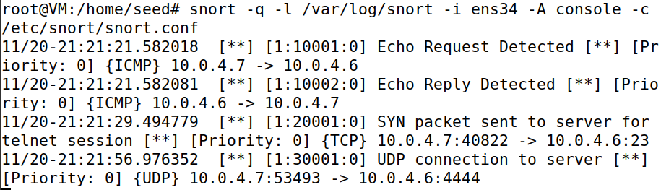
Testing Rules

Slide 17
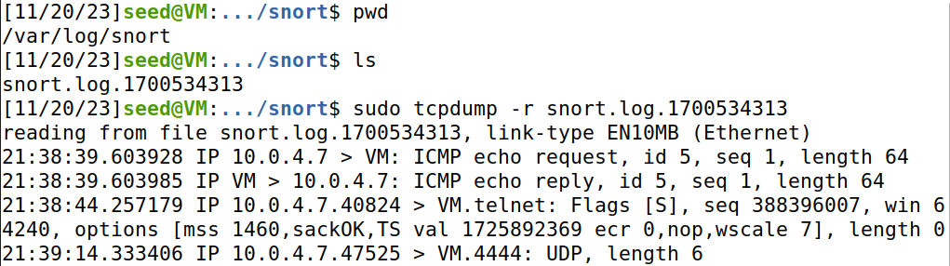
Viewing Log Files

Slide 18
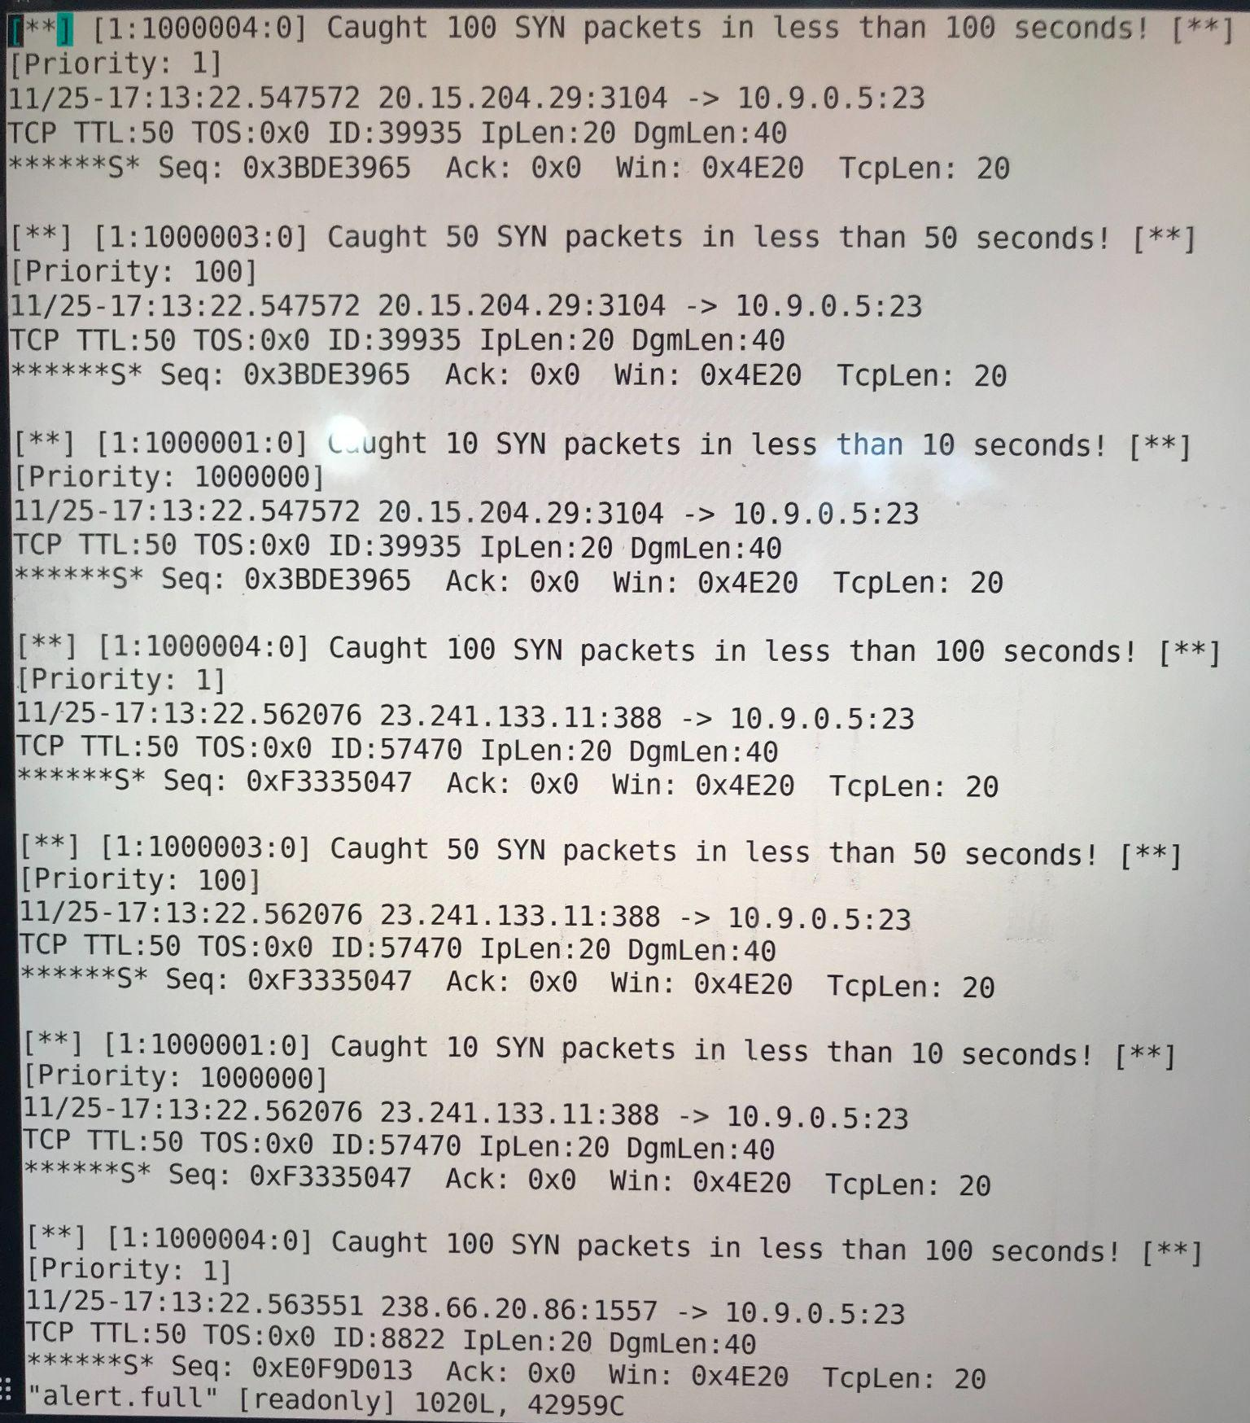
Detecting Syn Flood
Notes:
alert tcp any any -> 10.9.0.5 23 (msg:"Caught 10 SYN packets in less than 10 seconds!"; threshold: type limit, track by_dst, count 10, seconds 10; priority: 1000000; flags:S; flow: to_server,not_established; sid: 1000001;)

Slide 19
References
Cisco Talos Detection Response Team. (n.d.). Snort 3 rule writing guide. https://docs.snort.org
Christopher Davis (n.d.). SNORPY. Snorpy 2.0 - Web Based Snort Rule Creator. http://snorpy.cyb3rs3c.net

